Slide 1

Concept of Management

Slide 2
Learning Outcomes
To get aware about basic concepts of management.
Analyse yourself in terms of management skills.

Slide 3
ACTIVITY
ARE YOU READY TO BE A MANAGER?

Slide 4
Rate each of the following items based on what you think is the appropriate emphasis for that task to your success as a new manager of a department.
Your task is to rate the top four priority items as “High- Priority” and the other four as “Low- Priority”.

Slide 5
S. No. | Statement | High-Priority | Low-Priority
1. | Spend 50 percent or more of your time in the care and feeding of people.
2. | Make sure that people understand you are in control of the department.
3. | Use lunches to meet and network with peers in other departments.
4. | Implement the changes that you believe will improve department performance.
5. | Spend as much time as possible talking with and listening to subordinates.
6. | Make sure that jobs out on time.
7. | Reach out to your boss to discuss his or her expectations for you and your department.
8. | Make sure that you set clear expectations and policies for your department.

Slide 6

INTERPRETATION
Odd- numbered items are considered more important than the even- numbered items for long-term success as a manager.

Slide 7

WHAT IS MANAGEMENT?
attainment of organizational goals
IN
effective and efficient manner
BY
planning, organizing , leading and controlling organizational resources

Slide 8
EFFECIENCY AND EFFECTIVINESS IN MANAGEMENT
Efficiency (Means) Effectiveness (Ends)
Resource Usage
(Low Wastage)
Goal Attainment
(High Attainment)
Management strives for :
Low Resource Waste (High Efficiency)
High Goal Attainment (High Effectiveness)

Slide 9
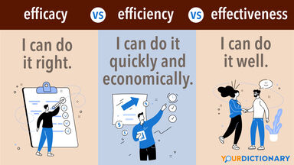

Slide 10
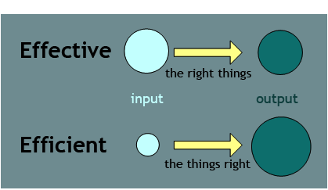
Effective and Efficient

Slide 11

So Now PONDER UPON…
Are you Effective?

Slide 12

Are you Efficient?

Slide 13
Are you Effective and Efficient both in doing a task?
“Give me examples”

Slide 14

Imagine…
You have no particular destination in your mind then any road will do.
BUT
If you have someplace in particular you want to go, you have got to plan the best way to go there.

Slide 15

Organizations always exist for achieving a particular goal
So
Management includes Planning, Organizing, Staffing, Leading and Controlling

Slide 16
Process of Management
Planning
------------
Setting goals, establishing strategies, and developing plans to coordinate activities
Organizing
----------
Determining what needs to be done, how it will be done, and who is to do it
Leading
-----------
Motivating, leading , and any other actions involved in dealing with people
Controlling
------------
Monitoring activities to ensure that they are accomplished as planned

Slide 17
Think of…..
Have you ever got frustrated when you have to spend two hours in a state government office to get your driver’s license renewed?

Slide 18

Will you be irritated when none of the salespeople in a retail store seems interested in helping you?

Slide 19

NEED FOR MANAGEMENT
All Organizational Areas
Manufacturing—Marketing—Human Resources and many more
Management is needed in …
All types of Organizations
Profit-------Not-for-profit
All Organization Levels
Bottom-----Top

Slide 20

To earn profit for business.
To get maximum results with minimum efforts.
To co-ordinate the various activities departments.
To interact with outsiders..
To fulfil social responsibility.

Slide 21
Characteristics of Management
Universal
Continuous Process
Management
Goal -Oriented
Multi-dimensional
Intangible

